Slide 1
BRANCH AND BOUND
-Namrata Prasad
-181210032
-CSE 2nd YEAR

Slide 2
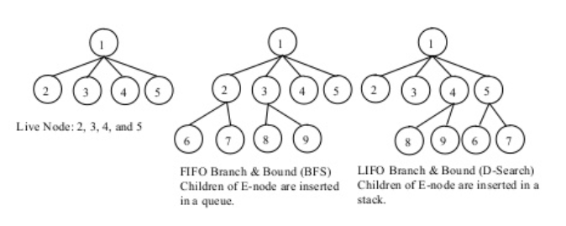
DESCRIPTION
Branch and bound is an algorithm design paradigm for discrete and combinatorial optimization problems, as well as mathematical optimization.
It is a state space search method in which all the children of a node are generated before expanding any of its children.
It has 3 major aspects:
Live-node: A node that has not been expanded.
Dead-node: A node that has been expanded
Solution-node: The node which represents the optimal solution

Slide 3
LEAST-COST SEARCH
This scheme associates a cost or profit with each node, C(x).
This is done to speed up the search for an answer node by using an “intelligent” ranking function, also called an approximate cost function.
If we are searching for a solution with least cost, then the list of live nodes can be set up as a min heap. The next E-node is the live node with least cost.
If we want a solution with maximum profit, the live node list can be set up as a max heap. The next E-node is the live node with maximum profit.

Slide 4
Requirements and Searching: LC search
Requirements
• Branching: A set of solutions, which is represented by a node, can be partitioned into mutually exclusive sets. Each subset in the partition is represented by a child of the original node.
• Lower bounding: An algorithm that is available for calculating a lower bound on the cost of any solution in a given subset.
Searching
Cost and approximation
Each node, X, in the search tree is associated with a cost: C(X)
C(X) = cost of reaching the current node, X (E-node), from the root + the cost of reaching an answer node from X.
C(X) = g(X) + h(X)
Least-Cost Search
The next E-node is the one with least/maximum C(x), as per required.

Slide 5
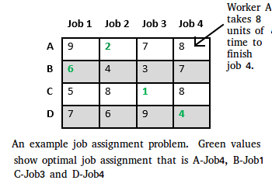
PROBLEM STATEMENT
Job Assignment Problem
Let there be N workers and N jobs. Any worker can be assigned to perform any job, incurring some cost that may vary depending on the work-job assignment. It is required to perform all jobs by assigning exactly one worker to each job and exactly one job to each agent in such a way that the total cost of the assignment is minimized.
2

Slide 6
ALGORITHM
algorithm findMinCost (costMatrix mat[][])
{
while (true)
{
E = Least();
if (E is a leaf node)
{
printSolution();
return;
}
for each child x of E
{
Add(x);
x->parent = E;
}
}
}
Least() finds a live node with least cost, deletes it from the list and returns it
Add(x) calculates cost of x and adds it to the list of live nodes

Slide 7
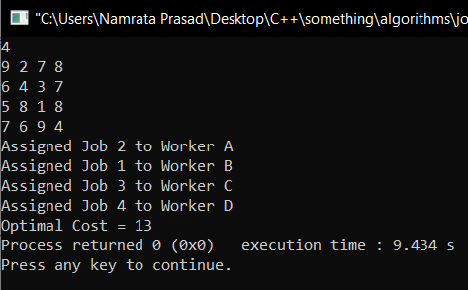
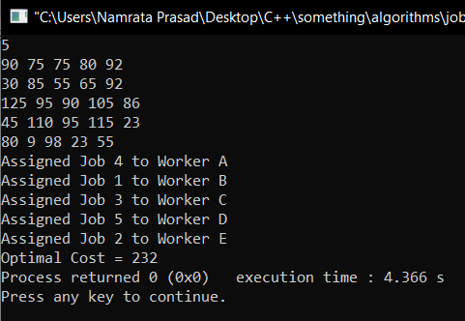
OUTPUTS
INPUT 1:
INPUT 2:

